Slide 1

Business Process Management Using Camunda
Yosef Samuel

Slide 2
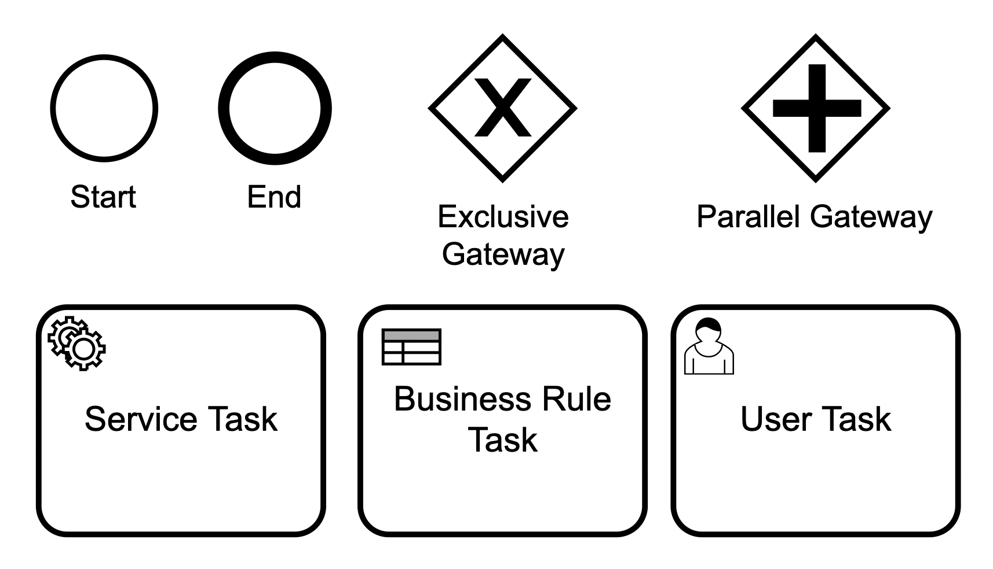
Basic flowchart symbols in Camunda

Slide 3
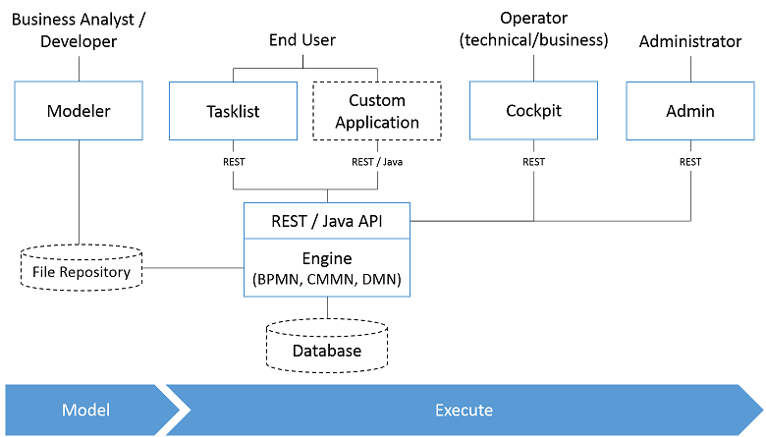
Camunda Component

Slide 4
Get started with Camunda and the Spring Boot
Tools :
IntelliJ IDEA Community Edition (https://www.jetbrains.com/idea/download)
Camunda Modeler (https://camunda.com/download/modeler/)
Camunda Platform Initializr : https://start.camunda.com/

Slide 5
Demo

Slide 6
Thank You ツ

